Slide 1
Key Biodiversity Areas, KBAs
Peter Jamal

Slide 2
Biodiversity Hotspots and KBAs

Slide 3
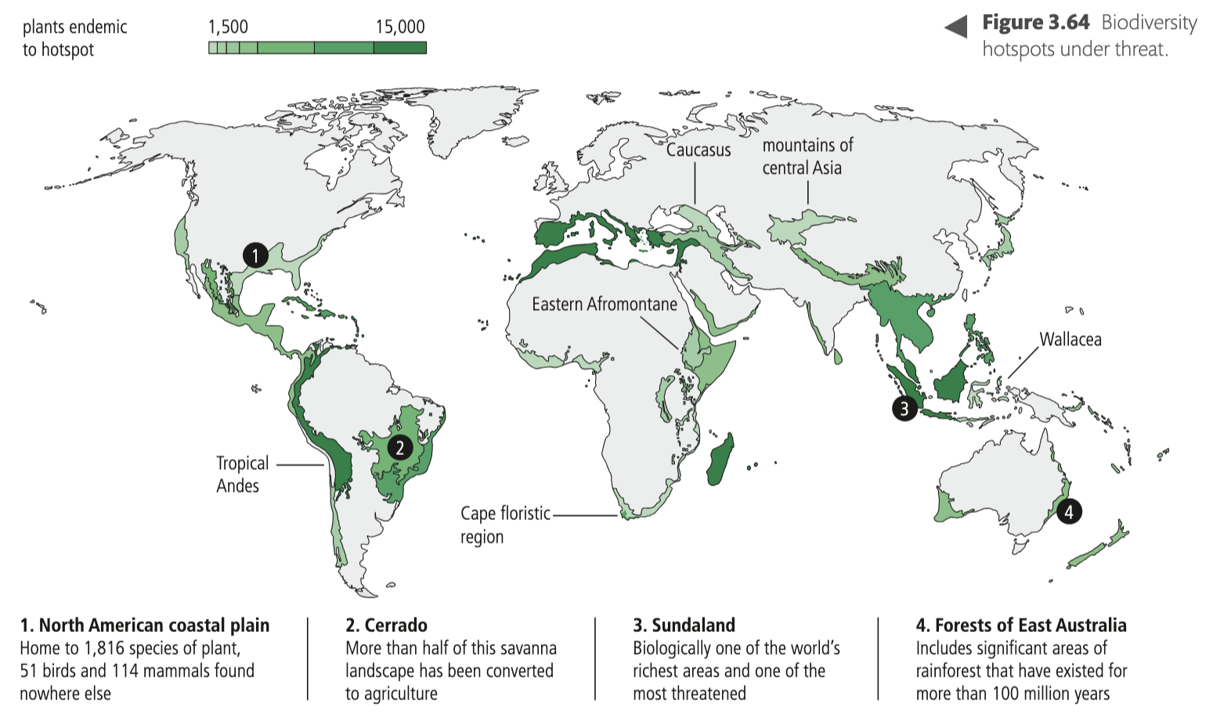
KBAs
Biodiversity hotspots under threats

Slide 4
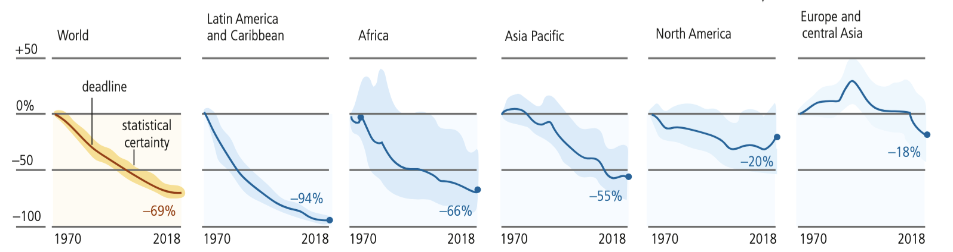
Biodiversity Hotspots
Biodiversity hotspots are under threat from habitat destruction, which could lead to a significant loss of biological diversity, especially in tropical biomes
Research indicates that animal populations have decreased rapidly by an average of 69% between 1970 and 2018

Slide 5
Key Biodiversity Areas, KBAs
KBAs are sites that contribute significantly to the global conservation of biodiversity in terrestrial, freshwater and marine environments.
KBAs are identified using taxonomic and ecological criteria and thresholds:
  presence of threatened species
  presence of threatened ecosystems
  geographically restricted species
  ecological integrity where the site remains ecologically intact, essentially
  unaffected by industrial human influence
  biological processes where the site holds a significant proportion of a species’
  population during one or more of its life stages, such as nesting, making it
  important for the continued survival of that species
  irreplaceability where the site has very high irreplaceability for the global
  persistence of biodiversity

Slide 6
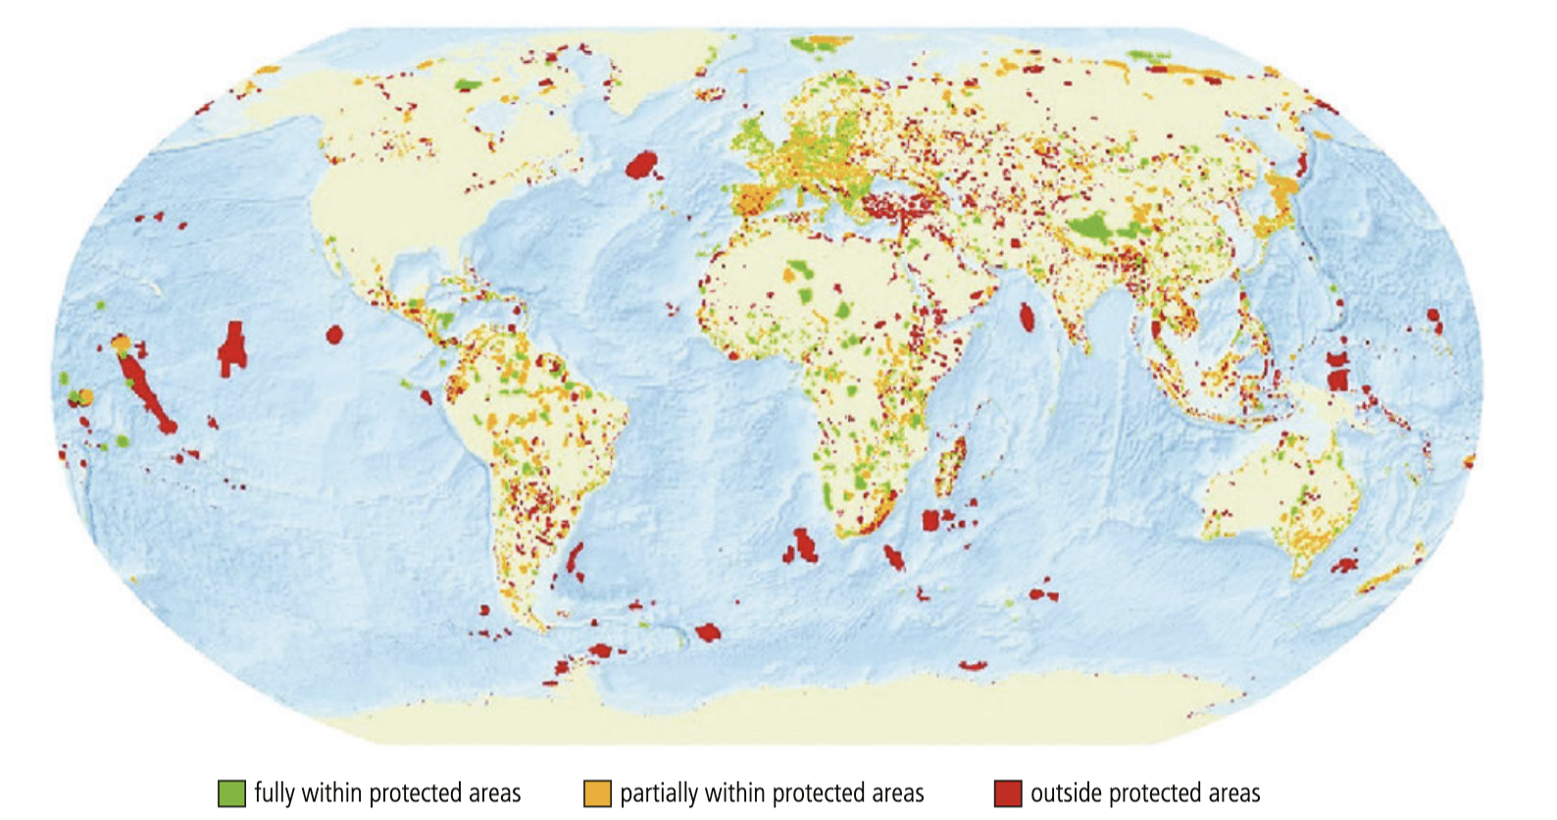
Key Biodiversity Areas, KBAs
Key biodiversity areas around the globe. KBAs are coloured whether they are fully within
(green), partially within (orange) or outside (red) protected areas on land and in the ocean.

Slide 7
Conflict between exploitation, sustainable development and conservation in KBAs
Developed countries have the luxury of being able to preserve their remaining natural ecosystems as they do not rely on these areas to provide income.
In addition, developed countries have already cleared the majority of their natural ecosystems.
For example, in the UK, the native forests were cleared to provide land for agriculture and timber to build ships.
Therefore, the argument for preserving the remaining diversity is on a different scale to the needs of developing countries where most tropical biomes are found.
For sustainable development to take place in developing countries, there needs to be a balance between conserving tropical biomes and using the land to provide income for the local economy.

Slide 8
Conflict between exploitation, sustainable development and conservation in KBAs
One of the traditional incomes from tropical rainforests was timber. For example, at the peak of logging operations in Borneo, trees were removed in large volumes of up to 100 m³ of wood per hectare.
  Conventional logging methods were not selective and caused damage to the remaining forest.
More recently, selective logging methods (also known as reduced-impact logging – RIL) have been used.
These techniques cause less damage, allow faster regeneration of forest and preserve forest structure and biodiversity better than conventional methods. Ecotourism can be used to provide ongoing income without destroying natural capital
Developing countries obviously wish to grow their economies and head towards developed country status, but the resulting conflict between exploitation, sustainable development and conservation can always be resolved providing there is local support and the political will to protect biodiversity before it is lost forever.
An example of conflict between exploitation, sustainable development and conservation is outlined [next slide]

Slide 9
Conflict between exploitation, sustainable development and conservation in KBAs
Tropical biomes are under constant threat.
Large areas of tropical rainforest with an average size of 1.5 hectares, the size of a football pitch, are lost every five seconds.
Deforestation and forest degradation are driven by external demands for timber, beef, land for crops such as soya, palm oil and biofuels.
Developing ‘carbon markets’ – which value ecosystems as stores of carbon (in vegetation) – could provide the means to give sufficient monetary value to rainforests to help protect them.

Slide 10
Conflict between exploitation, sustainable development and conservation in KBAs
Rainforests have thin, nutrient-poor soils.
Because there are few nutrients in the soil, it is difficult for rainforests to re-grow once they have been cleared.
Studies in the Brazilian Atlantic forest have shown that parts of the forest can return surprisingly quickly – within 65 years – but for the landscape to truly regain its native identity takes a lot longer – up to 4000 years.
Recovery depends on the level of disturbance – a large area of cleared land will take a lot longer to grow back, if it grows back at all, than small areas that have been subject to shifting cultivation.
Forest that has been selectively harvested for timber can grow back rapidly if only a few large trees have been removed.
A larger amount of timber removal may mean that the forest never fully recovers.
This is because fast-growing, light- loving species, such as vines and creepers, block out the light for slow growers, causing the forest to remain at a sub-climax level

Slide 11
Conflict between exploitation, sustainable development and conservation in KBAs
Land use in tropical areas is a contentious issue.
The widespread clearance of natural ecosystems so that land can be made available for plantations leads to biodiversity loss.
But the replacement plantations do provide valuable financial income, which is something that natural ecosystems on their own may not do.
Diversification of the local economy into areas such as ecotourism can provide alternative sources of income and take pressure off local habitats, as can the development of conservation areas

Slide 12
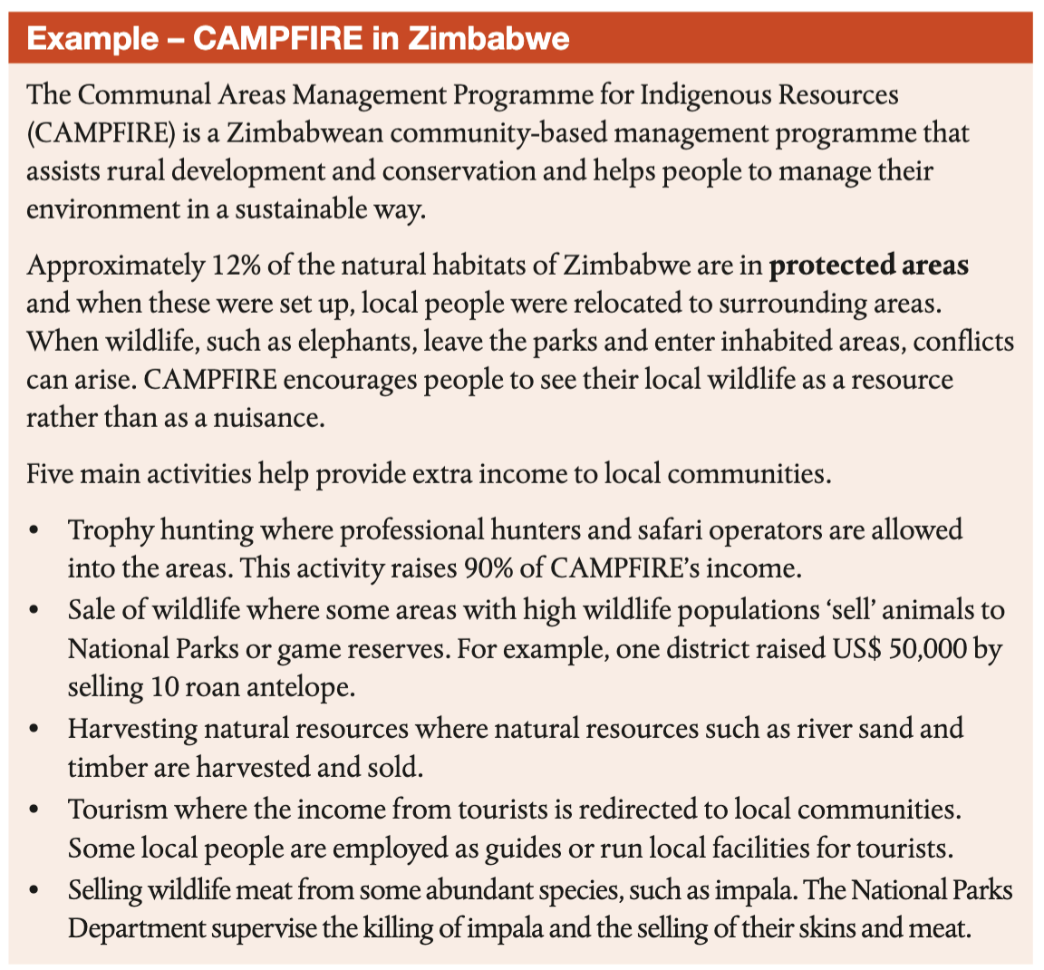
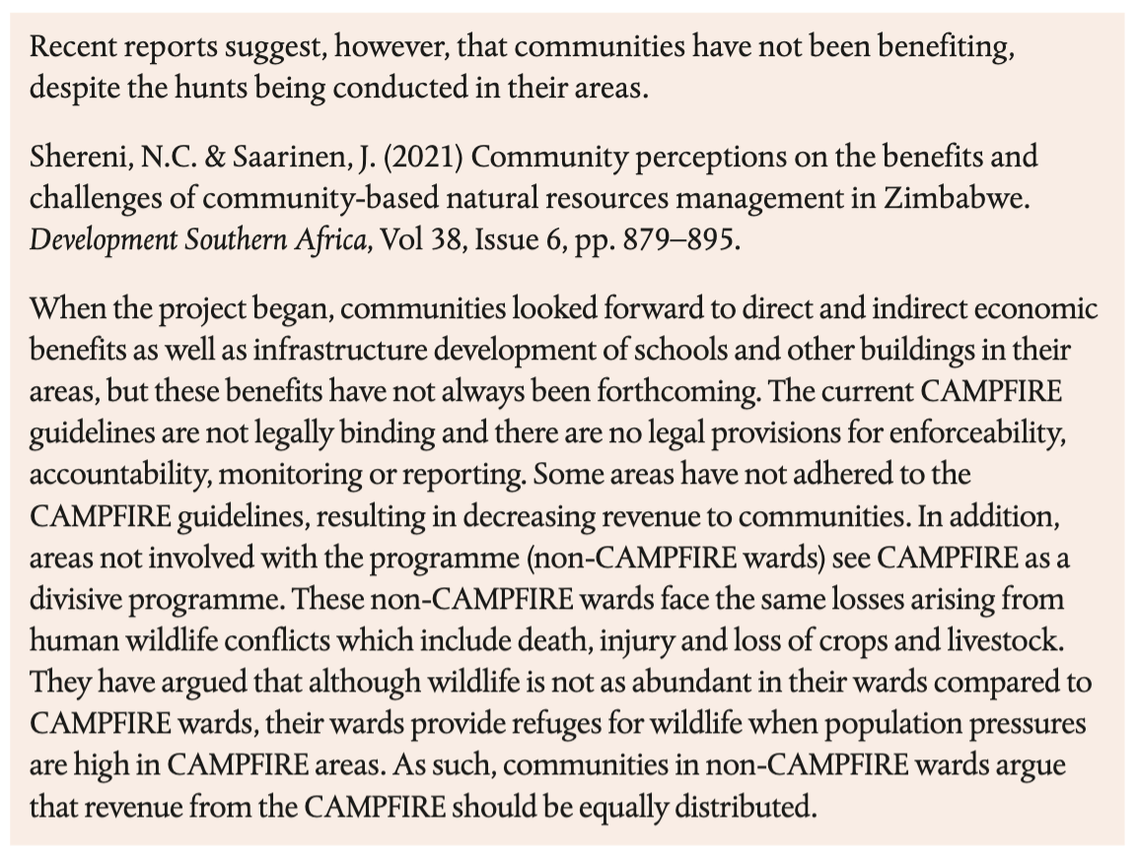
Conflict between exploitation, sustainable development and conservation in KBAs

Slide 13
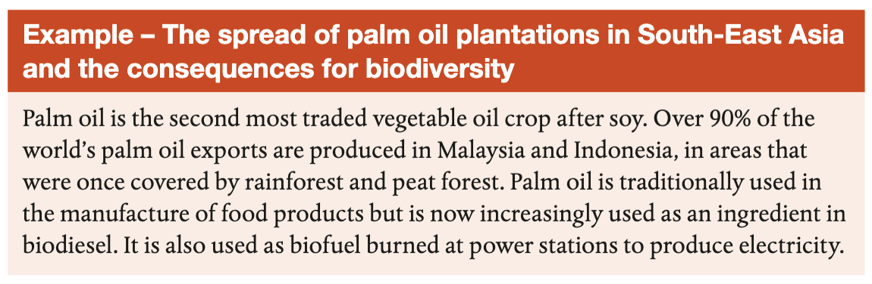
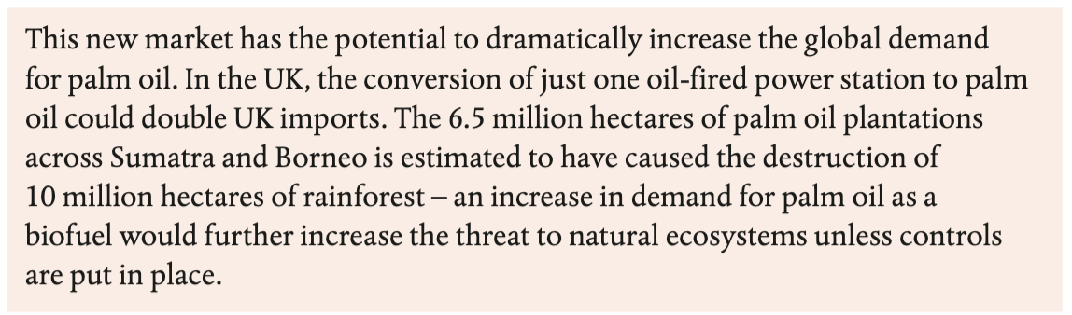
Conflict between exploitation, sustainable development and conservation in KBAs

Slide 14
Traditional indigenous approaches to land management

Slide 15
Traditional indigenous approaches to land management
Indigenous peoples are distinct social and cultural groups that share collective
ancestral ties to the lands and natural resources where they live.
Traditional indigenous approaches to land management can be seen as more
sustainable.
But the Indigenous peoples are facing challenges including population
growth, economic development, climate change and a lack of governmental support and protection.
Threats to the notions of the sustainability in traditional indigenous approaches often come from outside the community.
However, as the society develops economically and hopes to follow the development model of the rest of the world, threats may then come from within the community

Slide 16
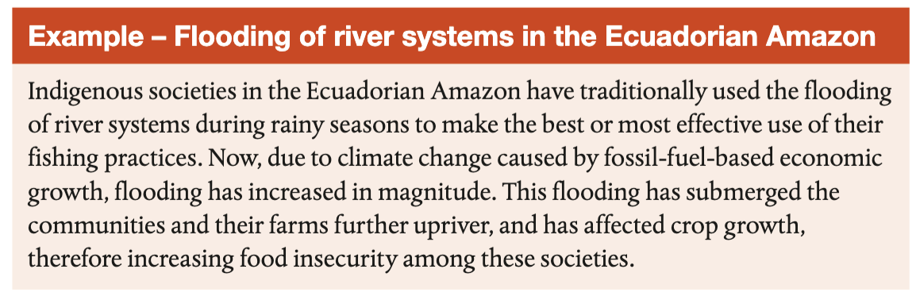
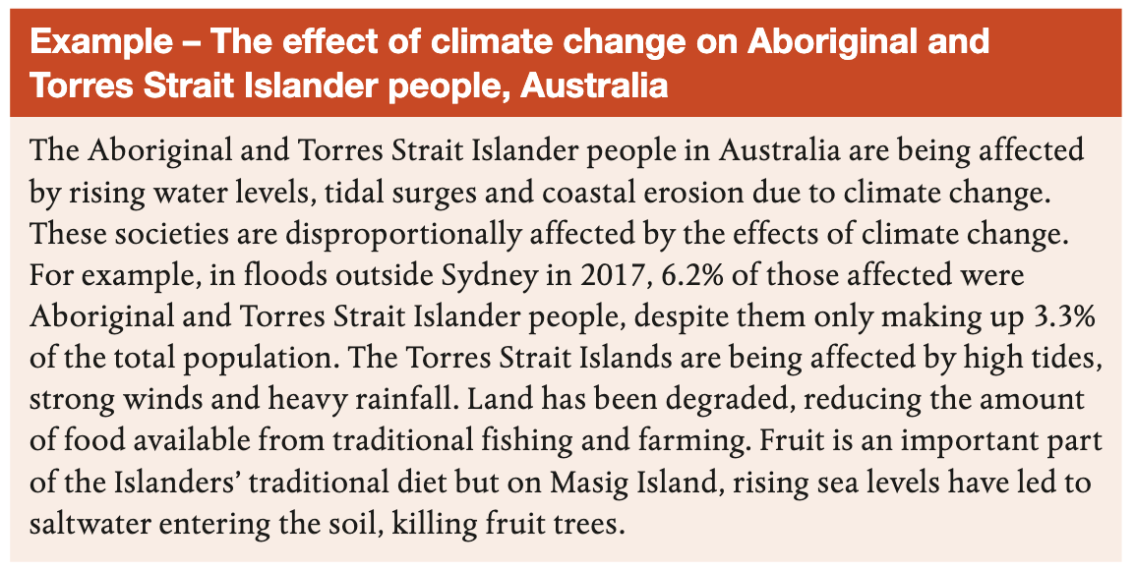

Slide 17
Environmental justice and conservation

Slide 18
Environmental justice and conservation
The areas of the world that are expected to experience significant negative effects from both the loss of biodiversity and ecosystem functions are likely to be those with large concentrations of
Indigenous people, such as rainforests
These communities may have a low income and no access to legal support (see Example – Maasai in Serengeti)

Slide 19
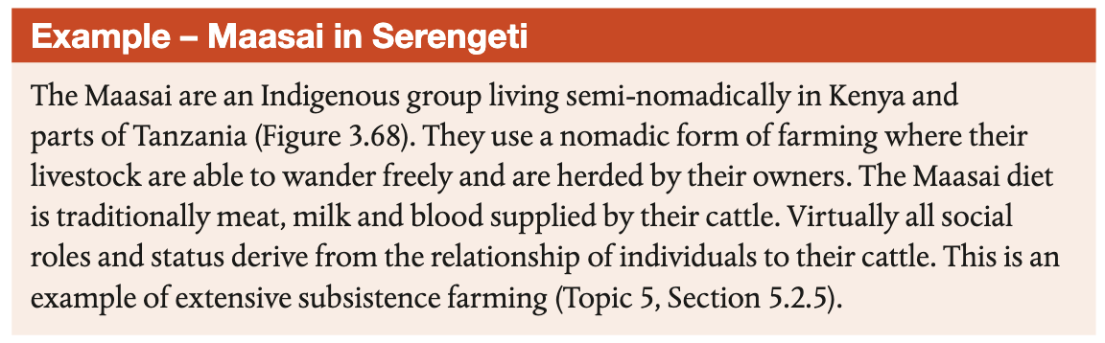
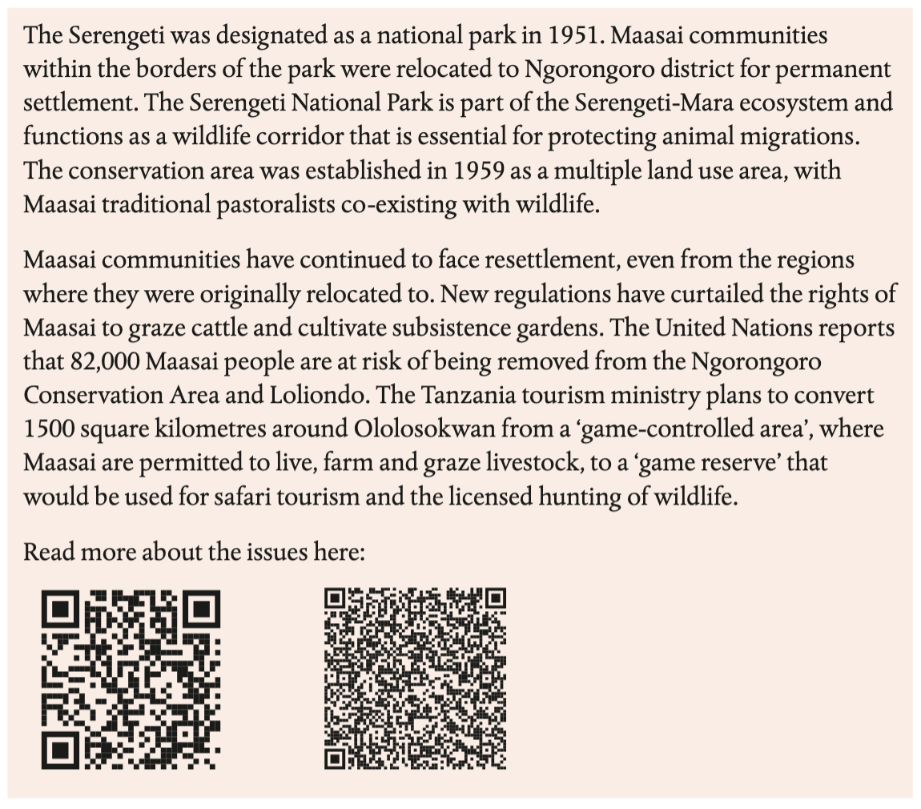
Environmental justice and conservation

Slide 20
Species extinctions have crossed a critical threshold

Slide 21
Species extinctions have crossed a critical threshold
The planetary boundary ‘Loss of biosphere integrity’ indicates that species extinctions have already crossed a critical threshold
There have been a number of natural periods of extinction and loss of diversity.
More recently, humans have played an increasing role in diversity loss, especially in biodiverse ecosystems such as rainforest and coral reef

Slide 22
Species extinctions have crossed a critical threshold
The background (natural) level of extinction known from the fossil record is between 10 and 100 species per year. Human activities have resulted in an increase in this rate.
Because the total number of classified species is a small fraction of the estimated total of species, estimates of extinction rates are also varied.
Estimates from tropical rainforest suggest the Earth is losing 27,000 species per year from those habitats alone.
The rate of extinction differs for different groups of organisms but examining the figures for one group (mammals) gives an indication of the extent of the problem.

Slide 23
Species extinctions have crossed a critical threshold
Mammal species have an average species lifespan, from origin to extinction, of about 1 million years.
There are about 5000 known mammalian species alive at present.
The background extinction rate for this group should be approximately one species lost every 200 years.
Yet the past 400 years have seen 89 mammalian extinctions, almost 45 times the predicted rate.
Another 169 mammal species are listed as critically endangered

