Slide 1
S2 Models of Bonding and Structure
S2.1 Ionic Model
S2.2 Covalent Model
S2.3 Metallic Model
S2.4 From Models to Materials

Slide 2
Overview of S2
Type of Bonding | Ionic | Covalent | Metallic | Intermolecular forces
Type of attraction | Electrostatic attractions
Species involved | Cations and anions | Non-metal atoms | Positively charged metal ions and sea of electrons | Molecules with varied polar properties
Formation | Electron transfer | Electron sharing | Electron freely moving in metals | H-bond Van der Waals Bridges (polymers)
Definition | Electrostatic attractions between oppositely charged ions (cations and anions) | Electrostatic attractions between positive nuclei and shared electrons | Electrostatic attractions between positively charged metal ions and the sea of electrons | H-bond: Between FON VDW: London, dipole-induced-dipole, dipole-dipole
Materials | Lattice | Giant lattice, polymers, allotropes | Metals and alloys | Polymers
S2.1
S2.2
S2.3
S2.2 and S2.4
S2.4

Slide 3
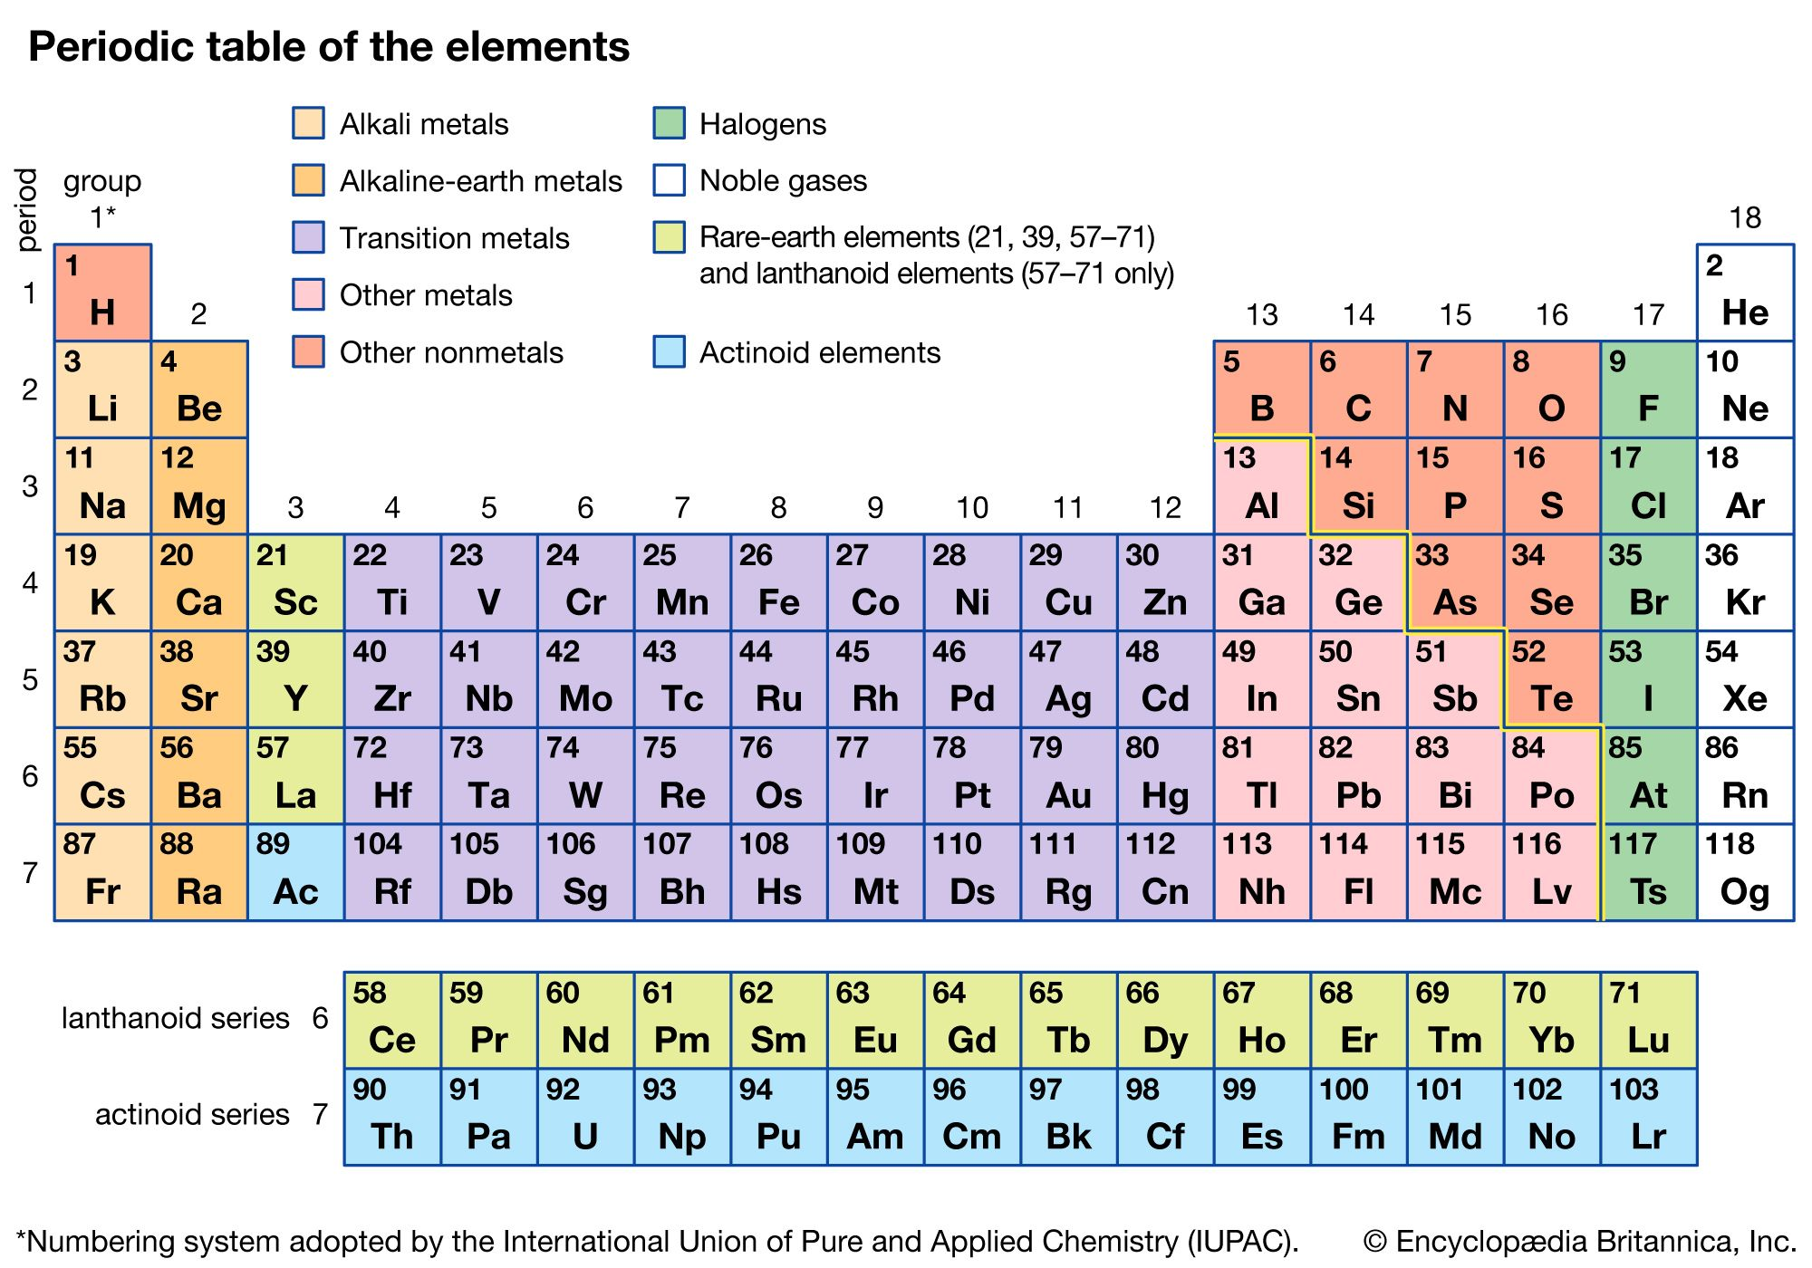
Fundamental of Interactions
Atoms of element either gain or losses electron so that the valence shell contains only 8 electrons (octet rule)
Atoms do so by loosing, gaining (ionic) or sharing electrons (covalent bond)

Slide 4
S2.1 The Ionic Model

Slide 5
S2.1 Objectives
Predict the charge of an ion from the electron configuration of the atom.
Deduce the formula and name of an ionic compound from its component ions, including polyatomic ions.
Interconvert names and formulas of binary ionic compounds.
Explain the physical properties of ionic compounds to include volatility, electrical conductivity and solubility.
Outline the lattice enthalpy as a measure of the strength of the ionic bond in different compounds, influenced by ion radius and charge.

Slide 6
Formation of ionic bonds
e–
Na losses an electron
By doing so, the new valence shell contains 8 electrons and now it is a cation with +1 charge
Cl accepts an electron
By doing so, the valence shell contains 8 electrons and now it is a anion with -1 charge
Na
Cl
Na⁺
Cl–
The cation (sodium) and anion (chloride) are attracted due to the opposite charge by electrostatic interaction

Slide 7
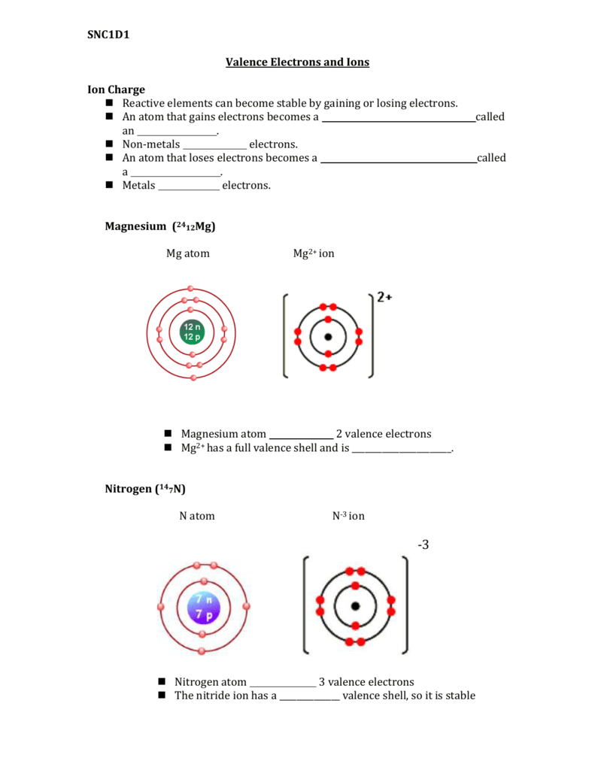
Formation of ions
2+
What happens?
3-
What happens?

Slide 8
Charges of ions
Ions form when atoms lose or gain electrons to achieve octet configuration.
Atoms with few valence electrons tend to lose them to form cations.
Atoms with many valence electrons tend to gain electrons to form anions
Group | Charge | Mechanism
1 | 1+ | Loses 1e
2 | 2+ | Loses 2e
13 | 3+ | Loses 3e
14
15 | 3- | Gains 3e
16 | 2- | Gains 2e
17 | 1- | Gains 1e

Slide 9
Stable Octet Rule
Atoms tend to either gain or lose electrons in their highest energy level to form ions
Atoms prefer having 8 electrons in their highest energy level or isoelectronic to the nearest noble gas
Examples
Na atom 1s² 2s² 2p⁶ 3s¹ One electron extra
Cl atom 1s² 2s² 2p⁶ 3s² 3p⁵ One electron short of a stable octet
Na⁺ Ion 1s² 2s² 2p⁶ Stable octet
Cl⁻ Ion 1s² 2s² 2p⁶ 3s² 3p⁶ Stable octet
The presence of d and f sub-orbits causes exceptions of noble gas isoelectronic and octet rule

Slide 10
Oxidation number of transition elements and irregular cases
Transition elements written in roman number i.e copper (I) oxide for Cu₂O or copper (II) oxide for CuO
elements that form ions that are not obvious from their group number are:
  Pb forms a stable ion Pb²⁺
  Sn forms Sn ⁴⁺ and Sn ²⁺
  Ag forms the ion Ag ⁺
  H can form H ⁻ (hydride)

Slide 11
Polyatomic ions
ammonium NH₄⁺
hydroxide OH⁻
nitrate NO₃⁻
hydrogencarbonate HCO₃⁻
carbonate CO₃²⁻
sulfate SO₄²⁻
phosphate PO₄³⁻

Slide 12
Formula and naming ionic compound
Cations don’t change they elemental name
Anions change their names based on:
  If no oxygen is attached = “ide”
  If oxygen is attached = “ate”
The naming follows binary rule and cation is named first

Slide 13
Name the following compounds
  KOH
  Li₂CO₃
  LiHCO₃
  CuSO₄
  FeF₃
  NiCl₂
  TiO₄
  V₂O₅

Slide 14
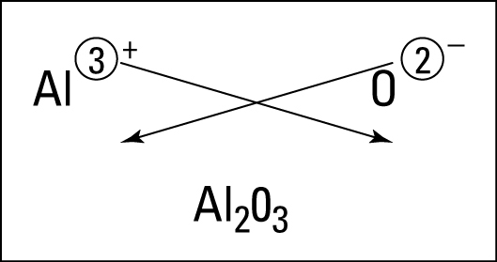
Forming an ionic
Write the formula of the following compounds:
Ammonium carbonate
Silver nitrate
Copper (II) nitrate
Barium sulfate
Beryllium nitride

Slide 15
S2.1 Objectives
Predict the charge of an ion from the electron configuration of the atom.
Deduce the formula and name of an ionic compound from its component ions, including polyatomic ions.
Interconvert names and formulas of binary ionic compounds.
Explain the physical properties of ionic compounds to include volatility, electrical conductivity and solubility.
Outline the lattice enthalpy as a measure of the strength of the ionic bond in different compounds, influenced by ion radius and charge.

Slide 16
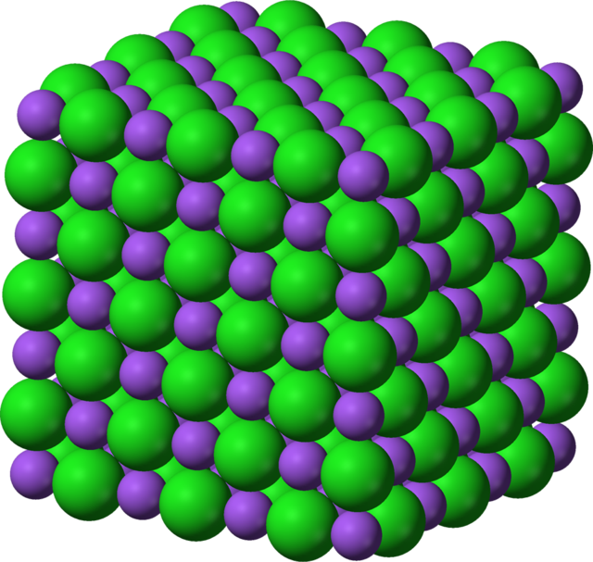
Lattice
A substance can be described as having a giant (lattice) structure or a molecular structure
Since ionic compounds cannot exist as an individual molecule, they are described as giant structure
  where there a repeating unit of the anion and cation next to one another until it together, they form a giant lattice structure
  The electrostatic force in the giant lattice is very strong – i.e hard to break

Slide 17
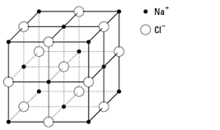
Analysis of NaCl lattice

Slide 18
Physical Properties
Melting and boiling points
Volatility
Solubility
Conductivity

Slide 19
Melting and boiling points
Hard to break the electrostatic forces (between cations) in the lattice
Therefore high energy is needed to melt
In general, high MP and BP
Some ionic compounds have low MP and BP such as ethylammonium nitrate

Slide 20
Volatility
Ionic compounds cannot easily turn into gas due to the strong electrostatic attractions
Low volatility

Slide 21
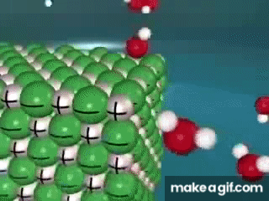
Solubility
Solubility in polar solvent
  Can pay back the amount of energy to break the lattice
  Therefore most ionic compounds can dissolve
  Cannot dissolve: most carbonates, most oxides, most hydroxides, most Ag salts (except with nitrates and fluoride), most lead (II) (except nitrate and ethanoate)
Solubility in non-polar solvent
  The amount of energy cannot pay back the energy owed to break the lattice. Therefore ionic compounds cannot dissolve in non-polar substance

Slide 22
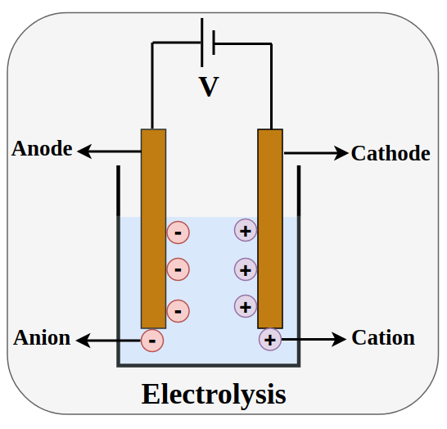
Electrical Conductivity
To conduct electricity, a substance must have at least or both of the following:
In solid form, ionic compounds have neither
Ionic compounds can only conduct electricity in molten or aqueous forms
At these states, the ions can also be separated. This process is called electrolysis

Slide 23
S2.1 Objectives
Predict the charge of an ion from the electron configuration of the atom.
Deduce the formula and name of an ionic compound from its component ions, including polyatomic ions.
Interconvert names and formulas of binary ionic compounds.
Explain the physical properties of ionic compounds to include volatility, electrical conductivity and solubility.
Outline the lattice enthalpy as a measure of the strength of the ionic bond in different compounds, influenced by ion radius and charge.

Slide 24
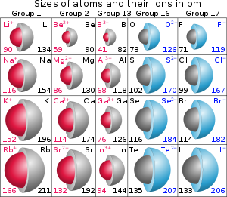
Ionic radii

Slide 25
Activity
Use the data booklet (Table 17)
Identify the trend of lattice enthalpy between:
  NaCl and KCl
  NaCl and CaCl2
  MgO and CaO
  Conclude: What are the two factors that influence the lattice enthalpy?

Slide 26
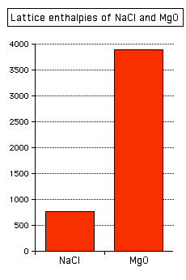
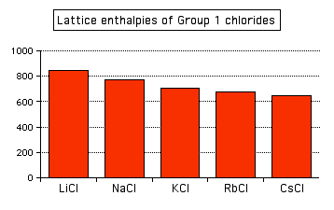
Lattice Enthalpy
Energy needed to break 1 mole of ionic solid to its constituent gaseous ions

