Slide 1
Topic 6 Atmosphere
Jamal, PMKH

Slide 2
Topic 6 Content
6.1 The Earth’s Atmosphere
6.2 Causes and Effects of Climate Change
6.3 Management Strategies of Climate Change
6.4 Stratospheric Ozone

Slide 3
6.1 The Earth’s Atmosphere
Knowledge Statements
The atmosphere forms the boundary between Earth and space. It is the outer limit of the biosphere and its composition and processes support life on Earth.
Differential heating of the atmosphere creates the tricellular model of atmospheric circulation that redistributes the heat from the equator to the poles.
GHGs and aerosols in the atmosphere absorb and re-emit some of the infrared (long-wave) radiation emitted from the Earth’s surface, preventing it from being radiated out into space. They include water vapour, carbon dioxide, methane and nitrous oxides (GHGs) and black carbon (aerosol).
The greenhouse effect keeps the Earth warmer than it otherwise would be due to the broad spectrum of the Sun’s radiation reaching the Earth’s surface and infrared radiation emitted by the warmed surface then being trapped and re-radiated by GHGs.

Slide 4
Part 1: Earth’s Atmospheric Layers

Slide 5
The Earth’s Atmosphere
Transitional boundary
  The atmosphere forms the boundary between Earth and outer space and serves as the outermost limit of the biosphere.
Composition:
  Nitrogen (N₂): 78%
  Oxygen (O₂): 21%
  Trace gases (~1%): carbon dioxide (CO₂), argon (Ar), neon (Ne), hydrogen (H₂), ozone (O₃), and variable water vapour (H₂O).
Greenhouse gases:
  CO₂ accounts for only 0.04% of gases but plays a critical role in the greenhouse effect.
  Human activities have increased concentrations of CO₂ and other GHGs, altering the climate.

Slide 6
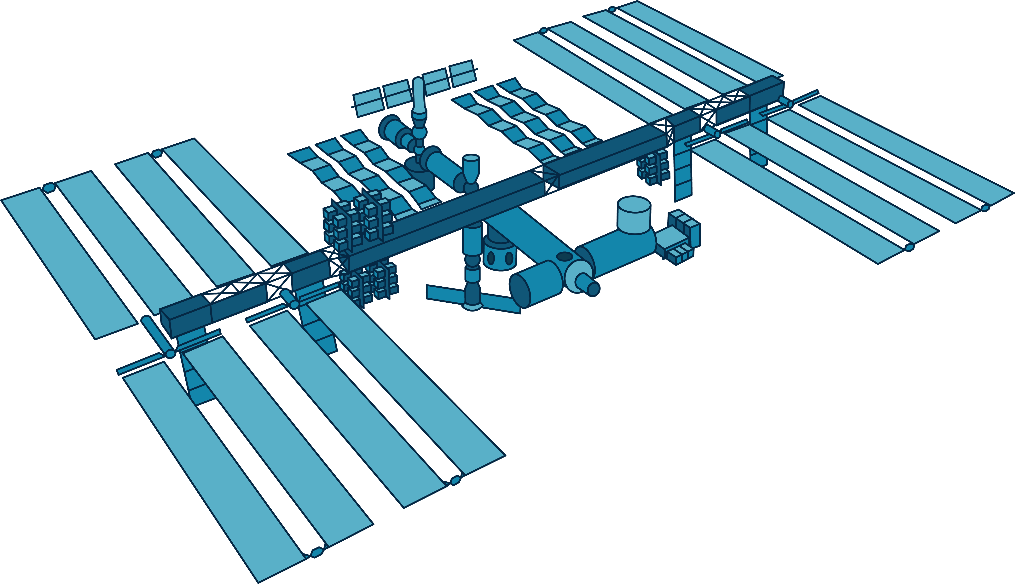




Outer Space
10 000 km
Exosphere
Decresing pressure
700 km
Thermosphere
80 km
Mesophere
50 km
Stratosphere
12 km
Tropophere

Slide 7
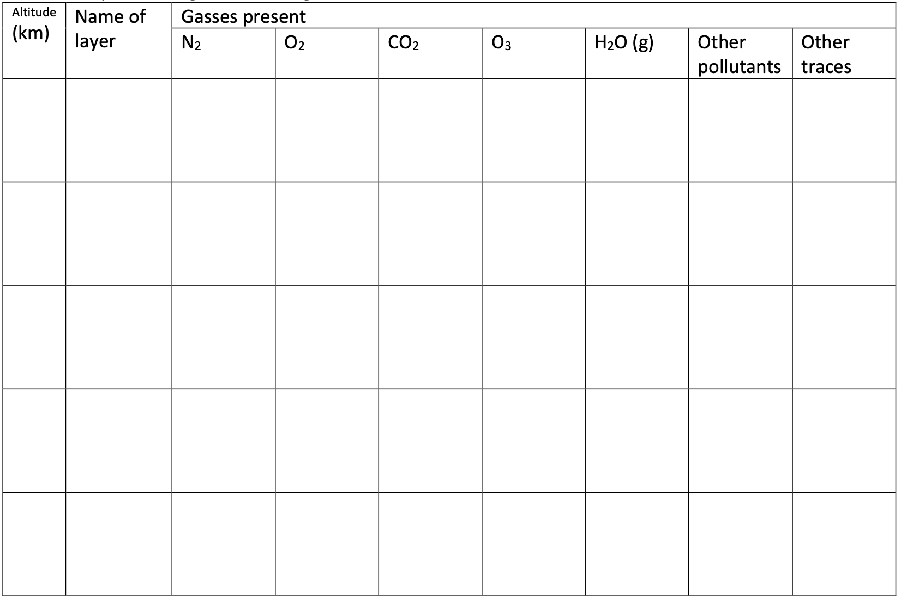
Activity 1
The atmosphere includes a mixture of gases; these gases are redistributed through physical processes, such as wind. Summarise the air compositions from troposphere and to exosphere using the following table

Slide 8
Activity 1 – The air compositions
Altitude (km) | Name of layer | Gasses present
 |  | N₂ (%) | O₂ (%) | CO₂ (%) | O₃ (%) | H₂O (g) | Other pollutants | Other traces
0–12 | Troposphere | 78 | 21 | 0.04 | 0.000004 | 0–4 | Smoke, dust, pollutants from humans | Argon ~0.93%, Ne, He, CH₄, Kr, Xe
12–50 | Stratosphere | 78 | 21 | 0.04 | 0.001–0.01 (ozone layer) | Very low | Volcanic ash, pollutants from stratospheric injection | Argon, Ne, He
50–85 | Mesosphere | 78 | 21 | 0.04 | Very low | Negligible | Meteor dust | Argon, He, Ne
85–600 | Thermosphere | 50–70 (lower) | 20–30 (lower) | <0.04 | Very low | Negligible | Very low | Atomic O, He, H
600+ | Exosphere | Trace | Trace | Trace | Negligible | Negligible | Almost none | H, He dominate

Slide 9
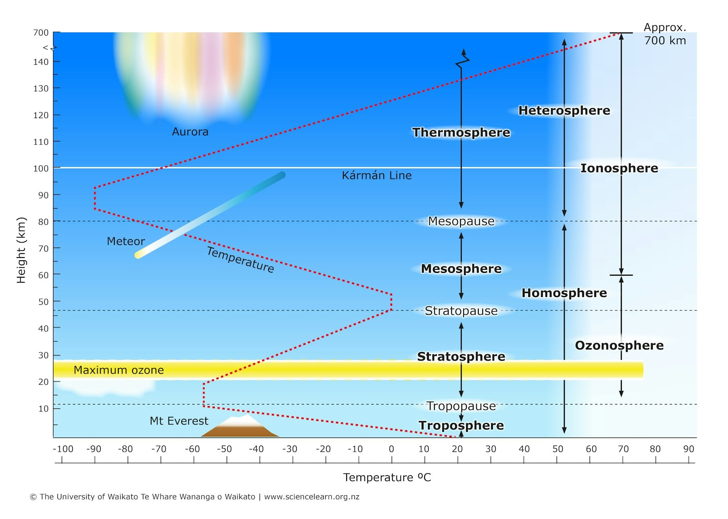
Change in P and T

Slide 10
The Earth’s Atmosphere
Altitude and life processes:
  Atmosphere extends ~1,100 km above Earth’s surface.
  Most life-relevant processes occur in the troposphere (0–10 km) and stratosphere (10–50 km), e.g., ozone formation and cloud development.
Geological changes
  Atmospheric composition has fluctuated significantly over geological timescales, affecting ecosystems and living organisms.

Slide 11
The Atmosphere as a Dynamic system
Contains inputs, outputs, storages, and flows that regulate energy and matter.
Activity 2
  Draw a system diagram showing 2 flows and 2 transformations in the atmosphere

Slide 12
Redistribution of air and heat
Energy sources for Earth:
Primary: solar radiation (insolation).
Local sources:
  Urban heat islands (localized warming).
  Geothermal heat in tectonically active areas or thin lithosphere regions.
Driver of atmospheric circulation:
Unequal solar heating across latitudes.
Energy surplus between ~38°S and 38°N; energy deficit at higher latitudes.
Energy transported from low to high latitudes to restore equilibrium.
Link between air circulation and pressure:
Surface air converges into low-pressure regions → rises → diverges at tropopause.
High-altitude convergence → air descends → surface high pressure → diverges outward.
Global wind patterns shaped by spatial distribution of pressure systems and seasonal Sun movement.

Slide 13
Redistribution of air and heat
Heat and pollutants are transported globally via atmospheric circulation.
Water vapour content (relative humidity) varies spatially and temporally, influencing weather systems.
Heat redistribution occurs through tricellular circulation and atmospheric-oceanic interactions.
Global circulation is driven by uneven solar radiation:
  Equator receives maximum solar energy.
  Poles receive less energy, amplified by reflective ice and snow.
  Circulation prevents extreme temperatures: without it, equatorial regions would be too hot and polar regions too cold.

Slide 14
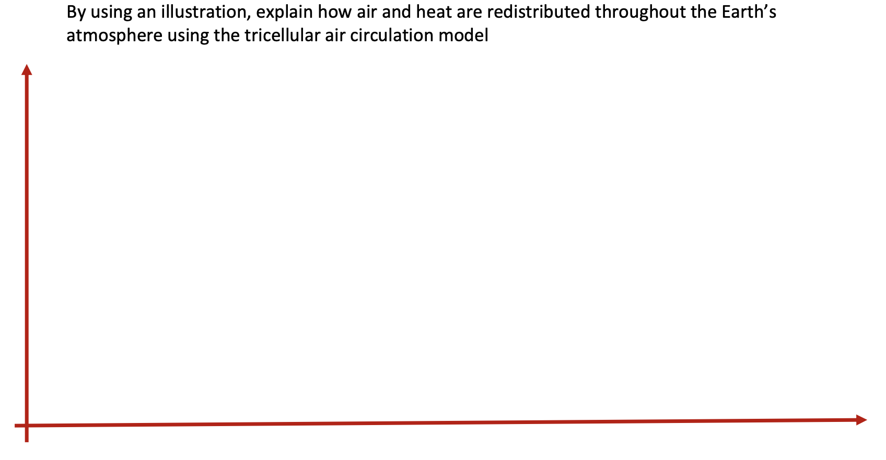
Activty 3

Slide 15
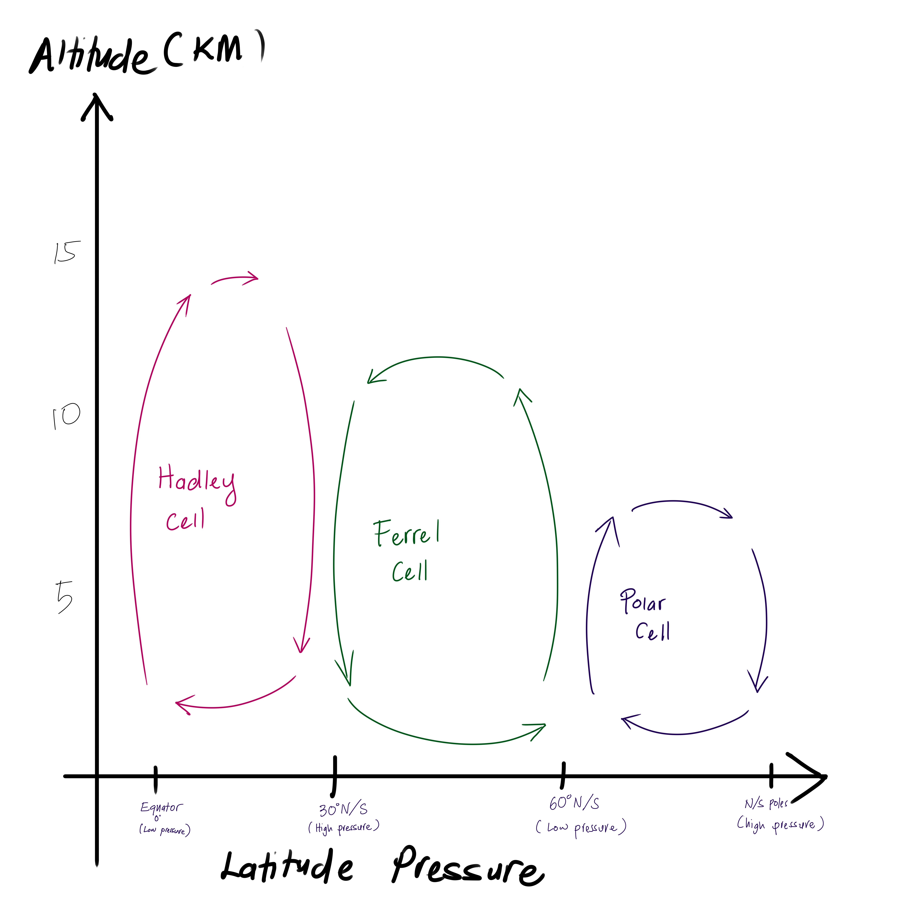
Redistribution of air and heat
Tricellular circulation model:
Comprises Hadley, Ferrel, and Polar cells.
Conceptual framework for large-scale movement of energy and air across the globe.

Slide 16
Redistribution of air and heat
Equatorial dynamics
Intense solar heating at equator → air rises → low-pressure zone.
Air moves poleward, cools, becomes denser → subsides in subtropics (~20–30° N and S) → high-pressure zones.
Some air returns equatorward → completes Hadley cell (convectional circulation).

Slide 17
Redistribution of air and heat
Polar cell
cold, dense air sinks over poles → polar high pressure → flows equatorward.
Ferrel cell
lies between Hadley and Polar cells, driven indirectly by interactions of adjacent cells.

Slide 18
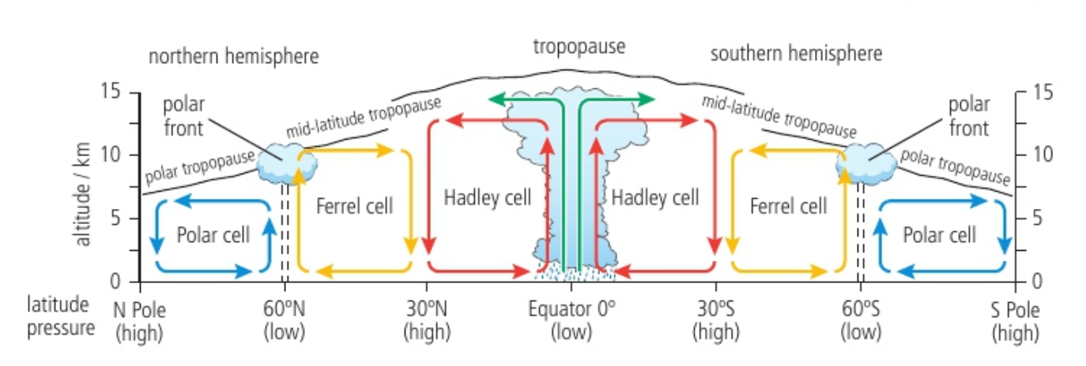

Slide 19
Part 2: Energy Budget

Slide 20
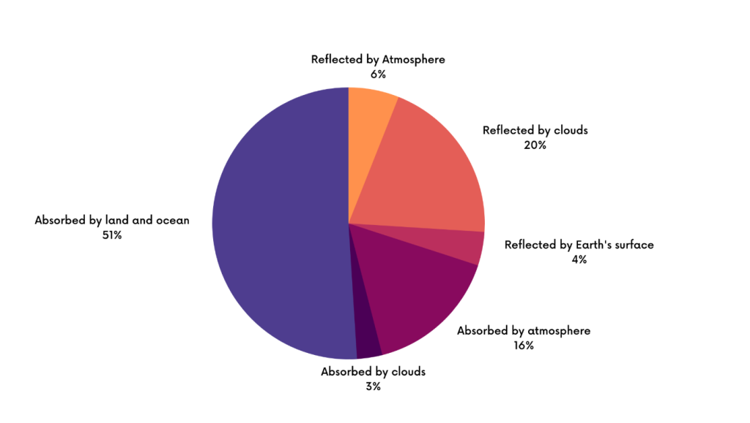
Earth's energy budget by percentage. Source: NASA

Slide 21
Energy balance
Earth maintains equilibrium between incoming and outgoing energy at the top of the atmosphere → called the Earth’s energy budget or radiation budget.
Stable global temperatures require incoming energy = outgoing energy.
Imbalance:
  Incoming > outgoing → planetary warming.
  Incoming < outgoing → planetary cooling.

Slide 22
Energy balance
Incoming solar energy:
  Primarily shortwave radiation.
  Mostly visible light, with smaller amounts of ultraviolet (UV) and infrared (IR).
  Reflection (albedo): ~30% reflected by clouds, aerosols, and Earth’s surface.
  Absorption: ~70% absorbed by the surface and atmosphere.
Role of absorbed energy:
  Drives photosynthesis.
  Heats land and oceans.
  Powers evaporation.
  Outgoing radiation:
  Warmed surface emits longwave (infrared) radiation back toward space.

Slide 23
Energy balance
Greenhouse effect:
  Greenhouse gases (GHGs) absorb and re-emit some outgoing longwave radiation back to the surface → called back radiation.
  Enhances surface warming.
  Critical in regulating Earth’s climate system.

Slide 24
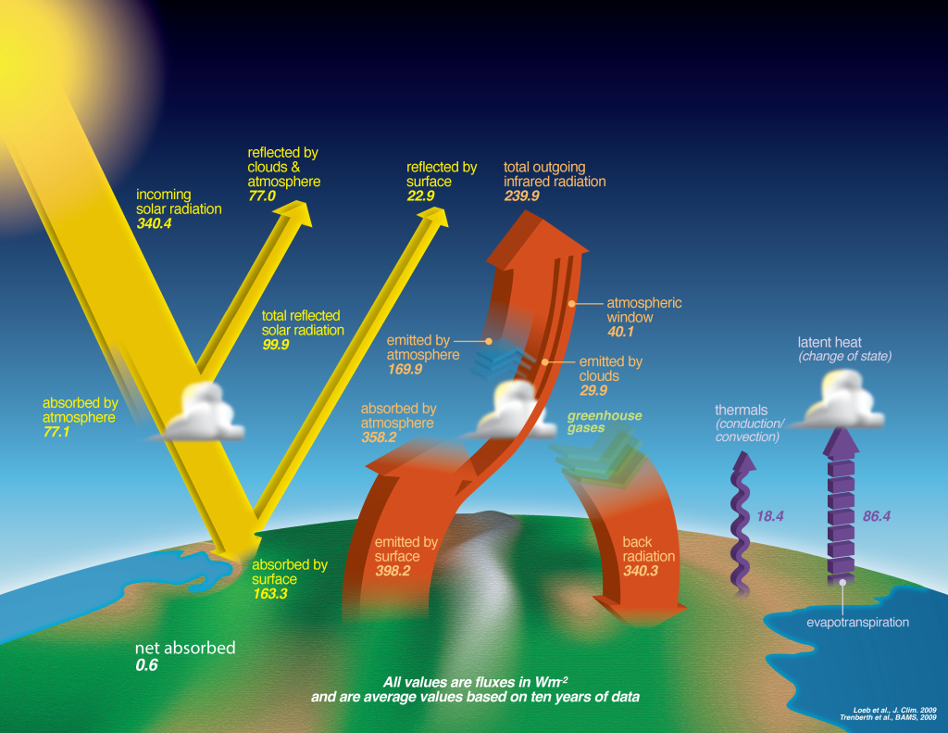
The Earht's energy budget. Source: NASA

Slide 25
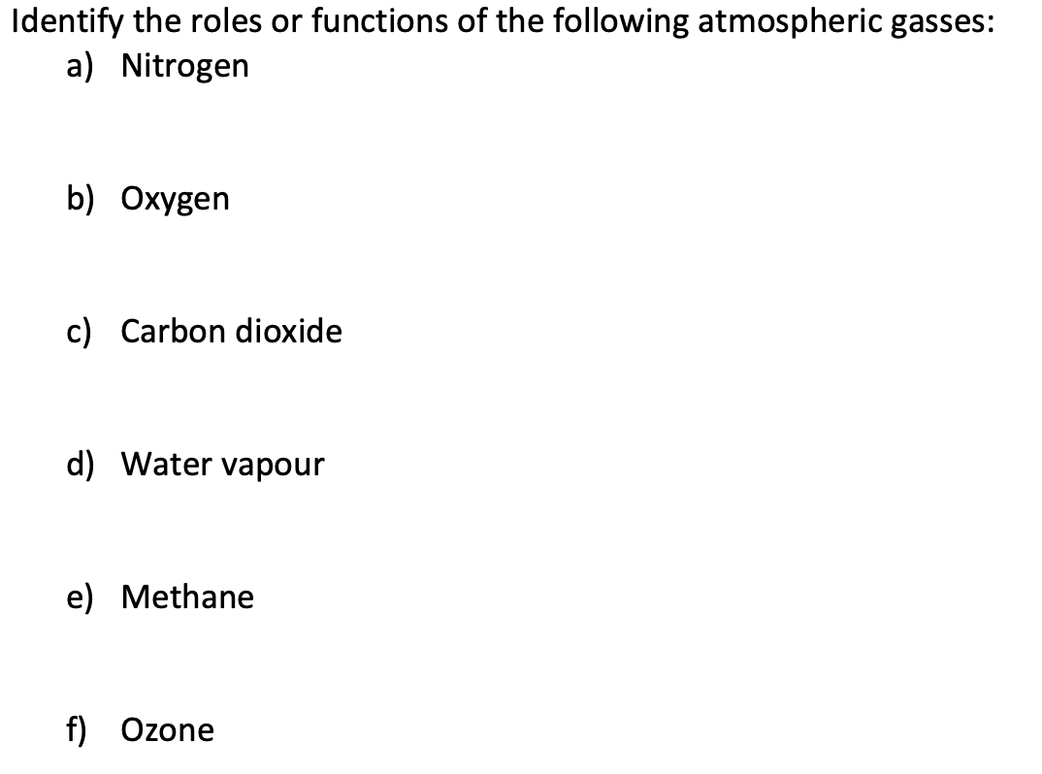
Activity 4

Slide 26
Part 3: Greenhouse Gasses and Aerosols

Slide 27
Roles of GHGs and aerosols
Warming effects:
  Allow incoming shortwave solar radiation to pass.
  Absorb outgoing longwave radiation, contributing to warming.
Cooling effects:
  Primarily from aerosols (e.g., sulphur emissions from human activities).
  Reduce the proportion of solar radiation reaching Earth → local/regional cooling.
  Can increase cloud cover → reflect more sunlight → phenomenon called global/regional dimming.

Slide 28
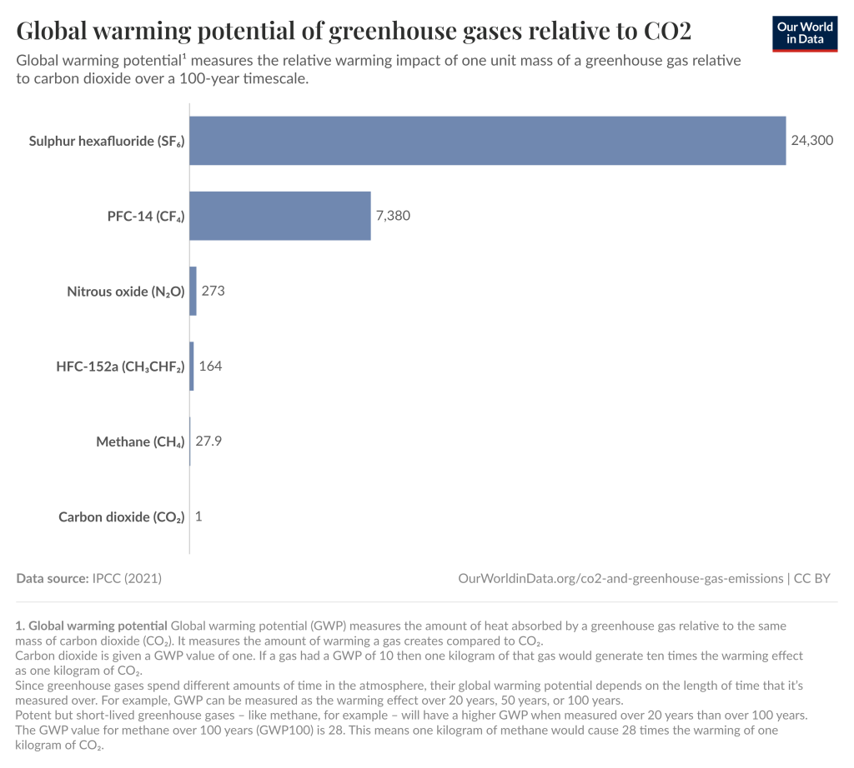
Major GHGs (although low potential):
  Water vapour (H₂O)
  Carbon dioxide (CO₂)
  Tropospheric ozone (O₃)
  Methane (CH₄)
  Nitrous oxide (N₂O)

Slide 29
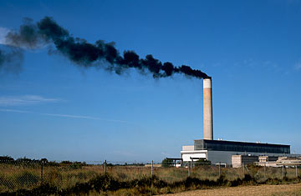
Black Carbon (Aerosol)
Sources:
  Biofuels: ~20% of global emissions
  Fossil fuels: ~40%
  Open biomass burning (savannahs, rainforests): ~40%
Properties:
  Fine particulate matter < 2.5 μm in diameter.
  Short atmospheric lifetime: days to weeks, removed by precipitation.

Slide 30
Climate Effects of Black Carbon
Direct effects:
  Absorbs sunlight in the atmosphere → reduces albedo.
Semi-direct effects:
  Alters atmospheric stability and cloud cover by absorbing solar radiation.
Snow and ice albedo effects:
  Deposition on snow and ice lowers albedo → positive feedback loop:
    Surface warming → accelerated ice melt → further albedo reduction.
Indirect effects:
  Changes cloud properties → influence absorption and reflection of solar radiation.
Significance:
  Combined direct and indirect snow–albedo effects → third largest contributor to positive radiative forcing since pre-industrial times (IPCC).
  Key driver of Arctic ice melt.
  Soot deposition on snow may account for up to 25% of observed global warming.

Slide 31
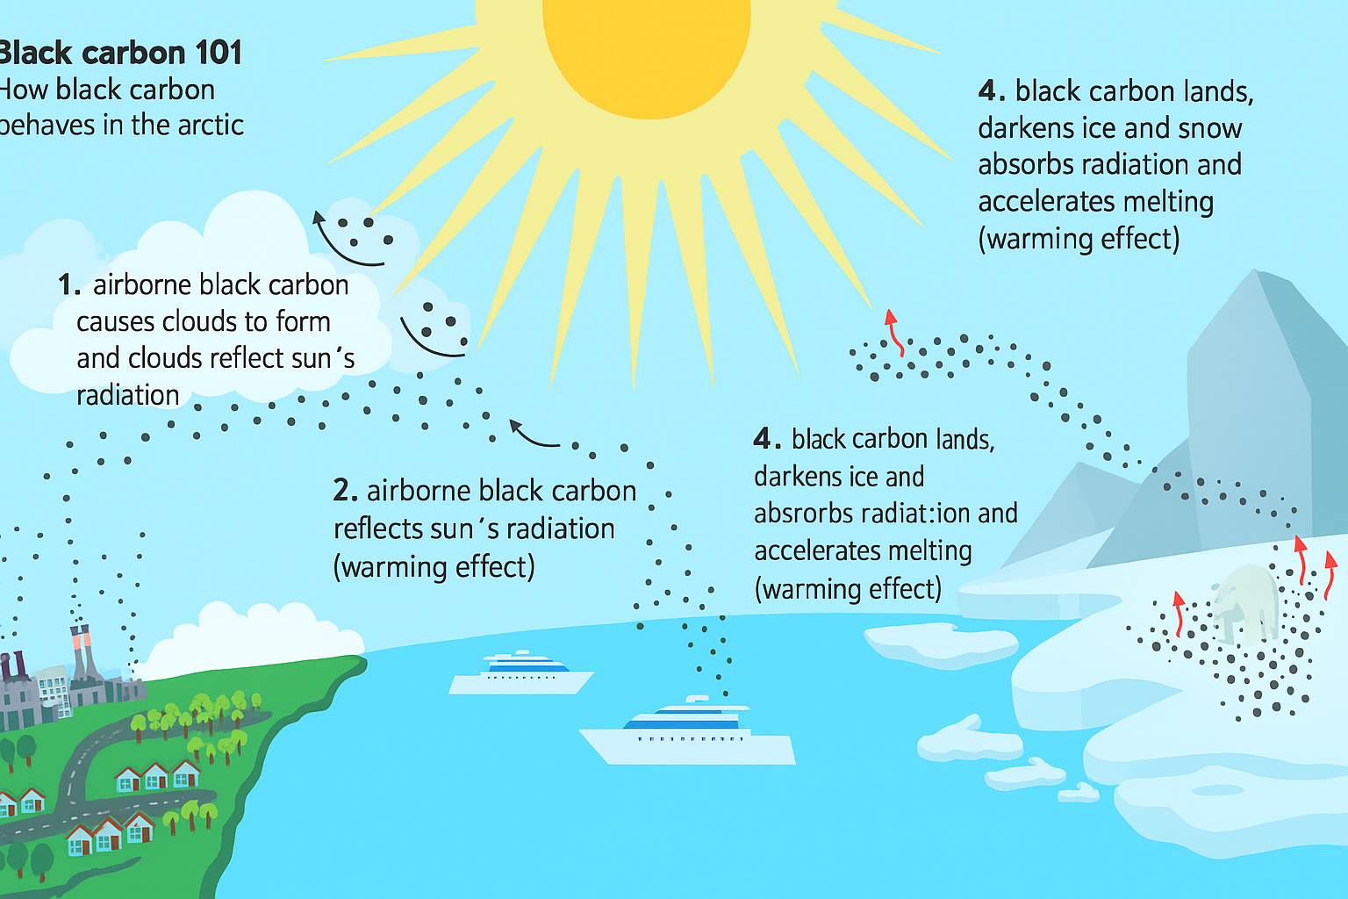
Black carbon lands on ice and darkens it. This reduces albedo
Black carbon cause cloud formation increading the reflection of sun’s radiation
Black carbon absorbd sun’s radiation
Black carbon reflects the sun’s radiation

Slide 32
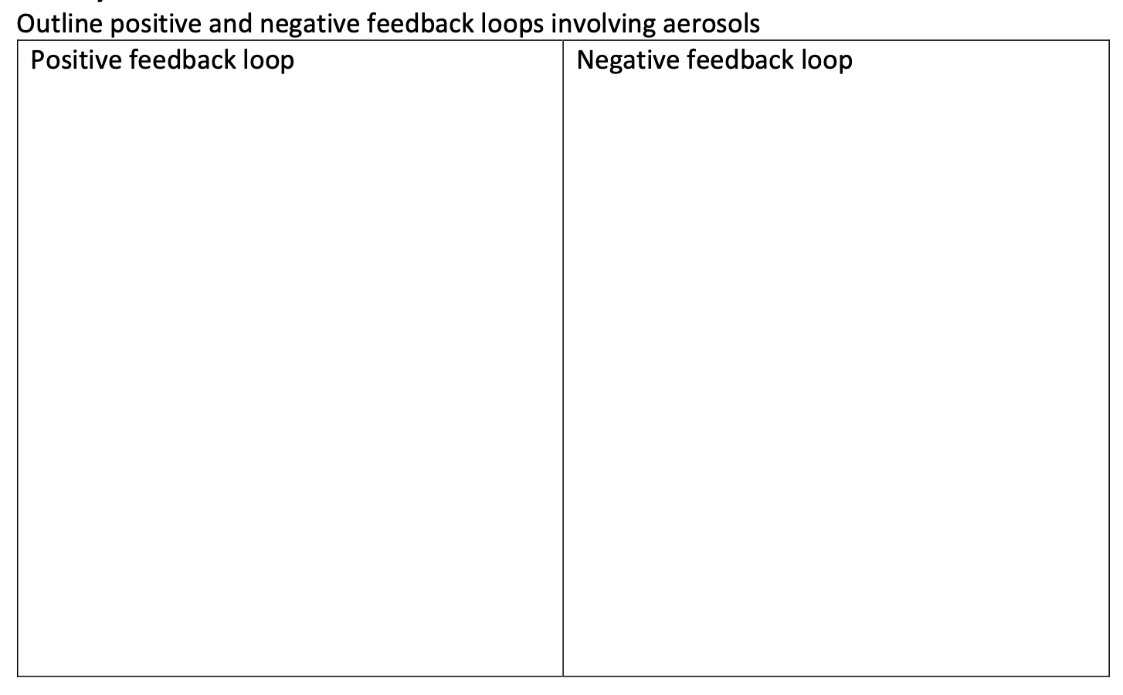
Activity 5

Slide 33
Part 4: The Greenhouse Effect

Slide 34
How Essential Greenhouse Effect is?
Definition:
  Natural process where greenhouse gases and aerosols absorb and re-emit longwave infrared (IR) radiation from Earth’s surface.
  Traps heat in the atmosphere → warms the planet.
Importance for life:
  Without it, Earth’s average surface temperature would be ~–18 °C instead of ~15 °C.
  Essential for maintaining habitable conditions.

Slide 35
The Greenhouse Effect
O₂ and N₂: Majority of the atmosphere; do not absorb or emit longwave radiation.
Greenhouse gases:
  Water vapour (H₂O)
  Carbon dioxide (CO₂)
  Methane (CH₄)
  Nitrous oxide (N₂O)
  Ozone (O₃)
These GHGs act as a thermal blanket by absorbing and re-radiating terrestrial radiation → natural greenhouse effect.
Persistent feature of Earth’s climate history.

Slide 36
Enhanced greenhouse effect (anthropogenic):
Caused by human activities
  fossil fuel combustion, industrial processes, land-use changes.
Increases GHG concentrations → raises global temperatures above natural baseline.
Leads to global warming, climate change, or climate crisis.
Contribution of gases:
  CO₂: Most significant due to high concentration and long atmospheric lifetime.
  Other gases (CH₄, N₂O, tropospheric O₃): Important; combined effect ≈ 60% of CO₂’s radiative forcing.

Slide 37
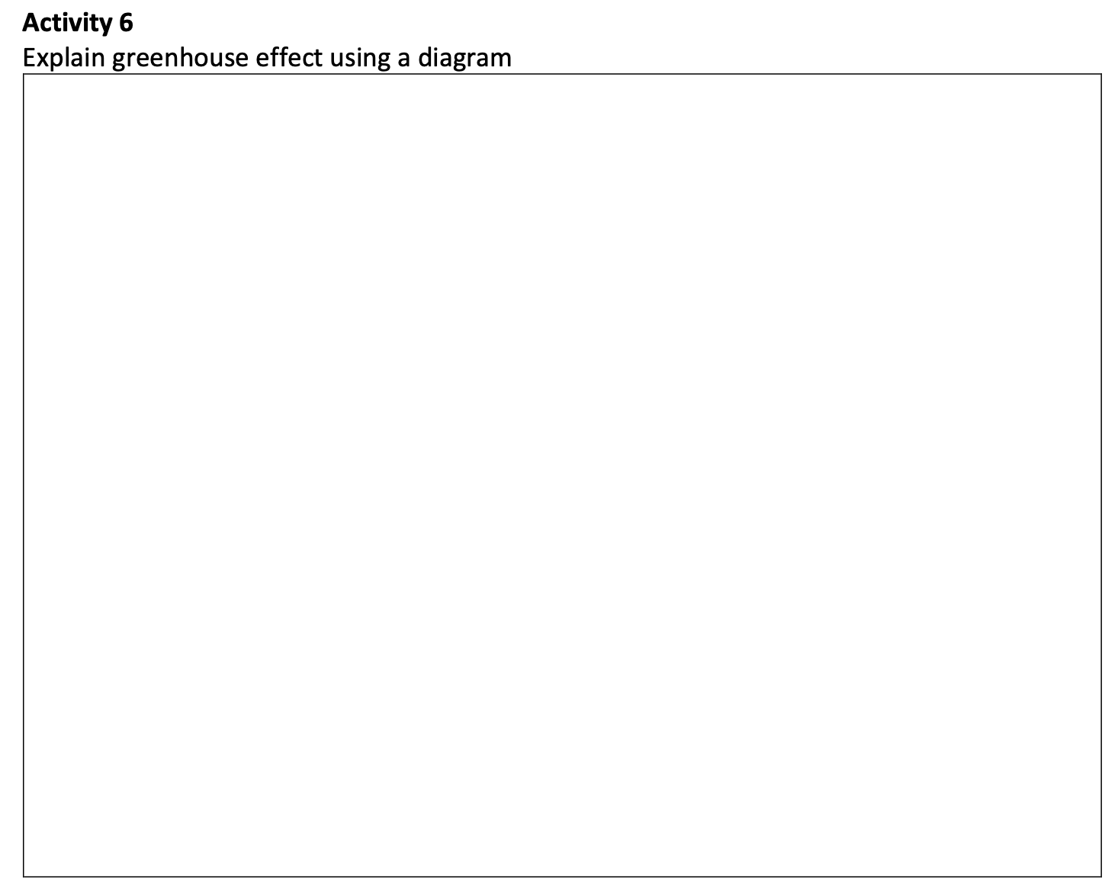
Activity 6

Slide 38
