Slide 1
IBDP Environmental Systems and Societies
Induction for Students

Slide 2
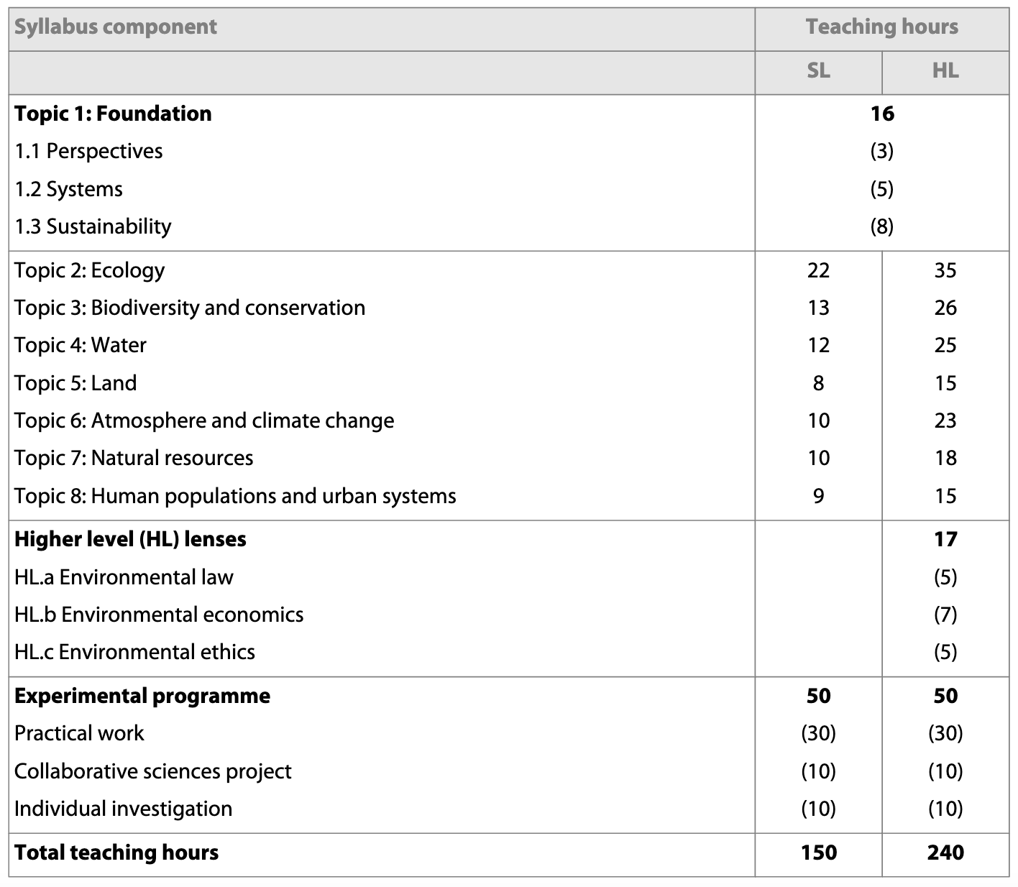
ESS Content
A group 4 subject – hence will also be in the collaborative science project with the other subjects in this group
Offered in SL and HL level. HL has deeper and wider explorations

Slide 3
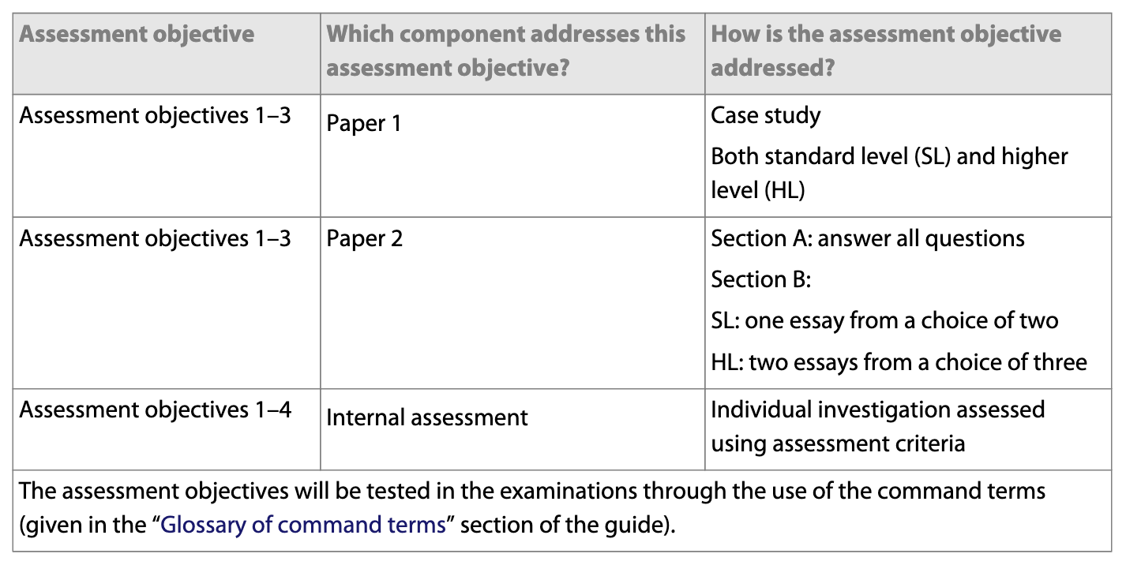
ESS Assessments

Slide 4
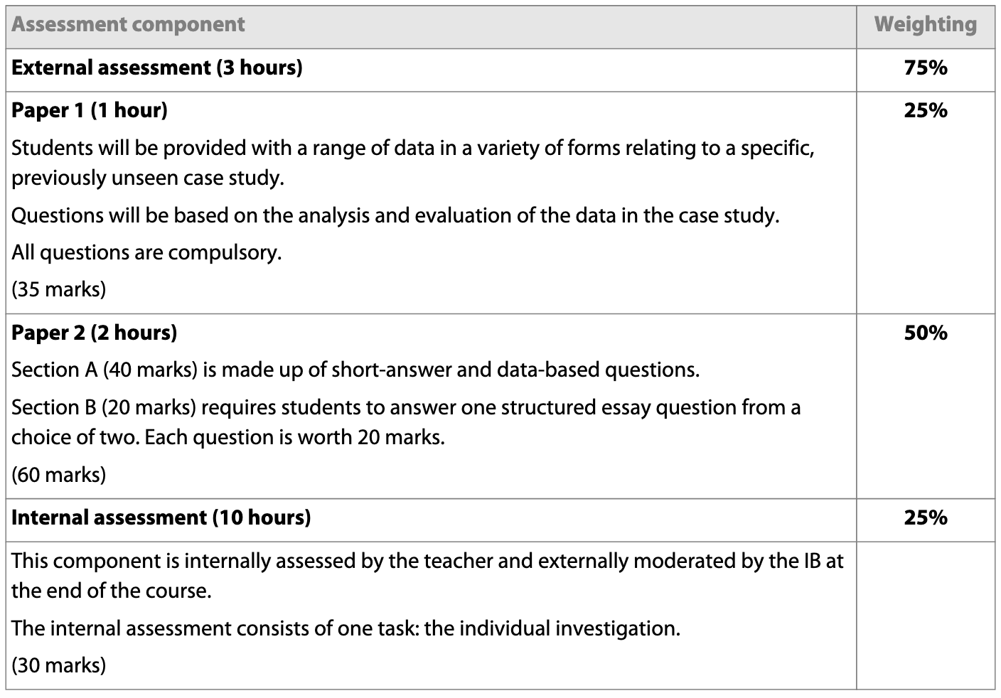
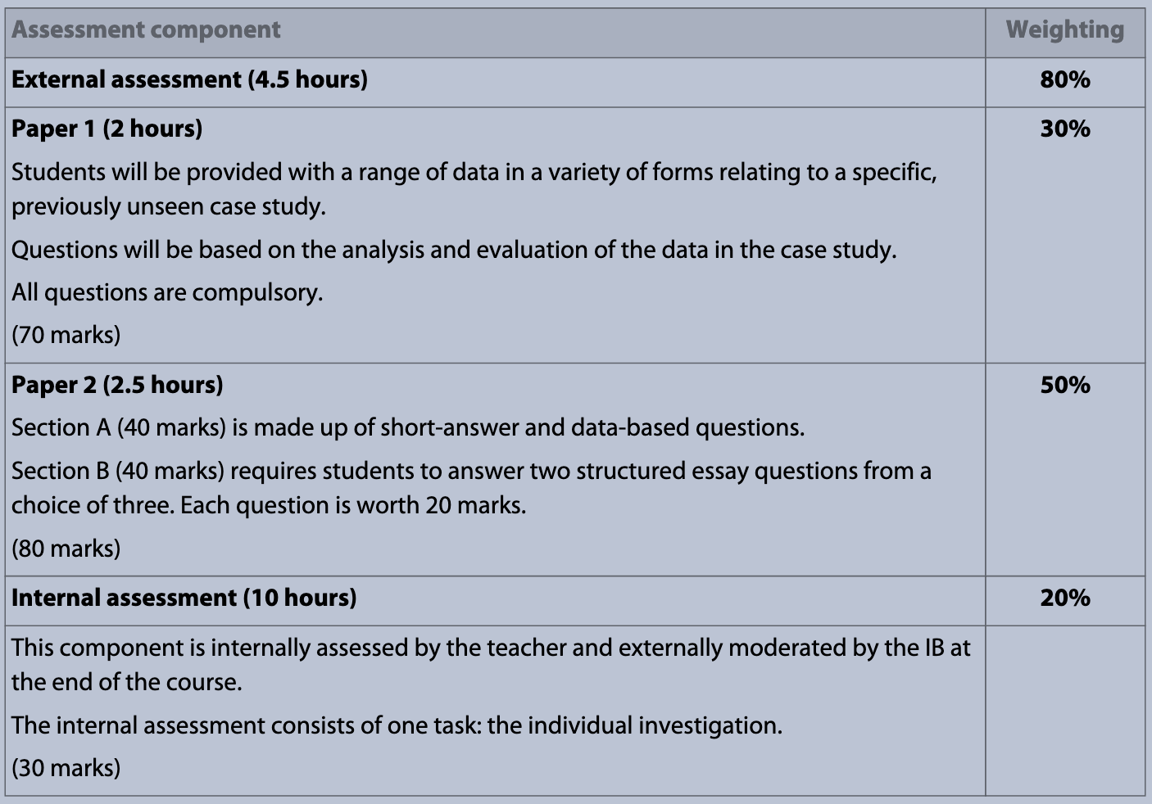
External Assessments
SL
HL

Slide 5
General about the Internal Assessment (IA)
The scientific investigation is an open-ended task in which the student gathers and analyses data in order to answer their own formulated research question
Personal investigation in the lab (must always be supervised)
Can work in a group (max 3) if methodology is similar, but IV and DV must be unique to individuals
10 hours of investigation
Only the lab report will be assessed – heavy assessment on critical thinking.
Same assessment rubric for SL and HL

Slide 6
IA Report
Using a template is recommended
Maximum 3000 words. Exclude:
  Charts and diagrams, data tables, equations, formulas and calculations.
  Citations/references (whether parenthetical, numbered, footnotes or endnotes)
  Bibliography
  Headers
The following details should be stated at the start of the report
  Title of the investigation, IB candidate code (alphanumeric, for example, xyz123), IB candidate code for all group members (if applicable), word count

Slide 7
IA Topics
The RQ should be of interest to the student – any Biology field within or without the IB Biology curriculum
The scientific investigation undertaken must have sufficient extent and depth to allow for all the descriptors of the assessment criteria to be meaningfully addressed.
The investigation of the RQ must involve the collection and analysis of quantitative data that should be supported by qualitative observations where appropriate.
The scientific investigation allows a wide range of techniques for data gathering and analysis to be employed.

Slide 8
IA Investigation Approaches
Hands-on practical laboratory work
Fieldwork
Use of a spreadsheet for analysis and modelling
Extraction and analysis of data from a database
Use of a simulation.

Slide 9
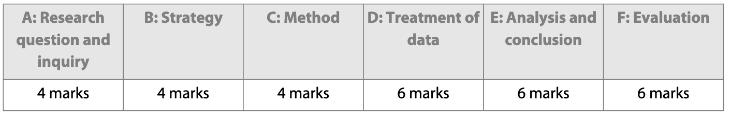
IA Criteria
[See IA Rubric supplementary document]

Slide 10
IA Academic Honesty
Referencing and academic integrity – all submitted work must be the student’s own work.
Where collaboration between students is permitted, it must be clear to all students what the difference is between collaboration and collusion.
Appropriate referencing to sourced information used in the report of the scientific investigation is expected.
Omitted or improper referencing will be considered to be academic malpractice.
A student’s failure to appropriately acknowledge a source will be investigated by the IB as a potential breach of regulations that may result in a penalty imposed by the IB Final Award Committee

